Slide 1
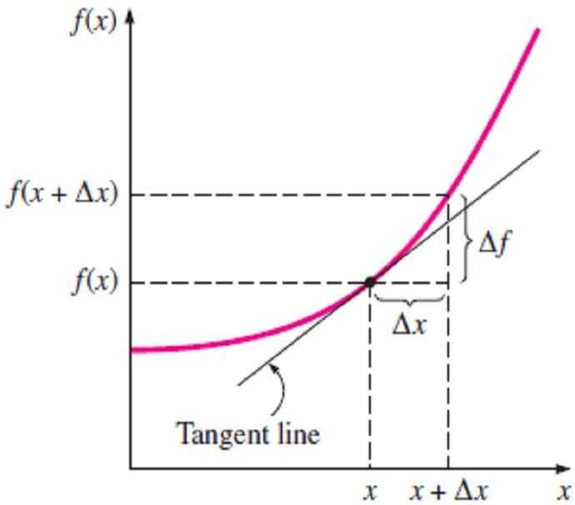
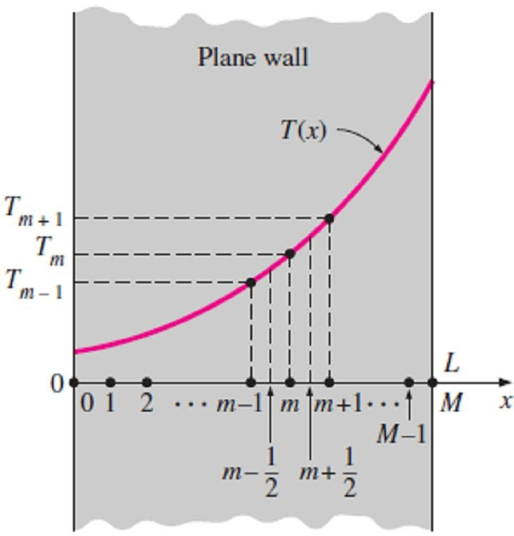
Chapter Five
Numerical Heat Conduction
5.1- Introduction
Analytical solution methods such as those presented in Chapter2 are based on solving the governing differential equation together with the boundary conditions. They result in solution functions for the temperature at every point in the medium. Numerical methods, on the other hand, are based on replacing the differential equation by a set of n algebraic equations for the unknown temperatures at n selected points in the medium, and the simultaneous solution of these equations results in the temperature values at those discrete points.
5.2- Finite Difference Formulation of Differential Equations
The numerical methods for solving differential equations are based on replacing the differential equations by algebraic equations. In the case of the popular finite difference method, this is done by replacing the derivatives by differences.
5.2.1- Finite Difference Formulation of 1st Order Derivative
Consider a function f that depends on x, as shown in Fig.(5.1). The first derivative of f(x) at a point is equivalent to the slope of a line tangent to the curve at that point and is defined as;
Fig.(5.1) The derivative of
a function at a point represents the slope of the function at that point
df (x) _{= lim} Δ f (x) _{= lim} f (x + Δx) − f (x)
☹(5.1.a)
dx Δx Δx
Δx → 0 Δx → 0
which is the ratio of the increment Δf of the function to the increment Δx of the independent variable when Δx  0.
Note- If we don’t take the indicated limit, we'll have the following approximate relation for the derivative;
df ( x) ≅ f ( x + Δx) − f ( x)
☹(5.1.b)
dx Δx
above approximate expression of the derivative in terms of differences is the finite difference form of the first derivative.
5.2.2- Finite Difference Formulation of 2nd Order Derivative
Consider steady one-dimensional heat transfer in a plane wall of thickness L with heat generation. The wall is subdivided into M sections of equal thickness Δx =L/M in the x-direction, separated by planes passing through M+1 points 0, 1, 2, . . . , m - 1, m, m + 1,
. . . , M called nodes or nodal points, as shown in Fig.(5.2). The x-
coordinate of any point m is simply x_{m} = m Δx, and the temperature at that point is simply T(x_{m}) = T_{m} . The heat conduction equation involves the second derivatives of temperature with respect to the space variables, such as d²T/dx², and the finite difference formulation is based on replacing the second derivatives by appropriate differences. But we need to start the process with first derivatives. By using Eq.(5.1.b), the first derivative of temperature
dT/dx at the midpoints m −
1
2
and m +
1
2
of the sections
Fig.(5.2) Schematic of the nodes and the nodal temperatures used in the finite differences formulation of heat transfer in a plane wall
surrounding the node m can be expressed as;
dT
dx _{m −} ¹
2
≅ ^{T}m ^{− T}m−1
and
dT
dx _{m +} ¹
2
≅ ^{T}m +1 ^{− T}m
☹ (5.2)
Δx
Δx

Slide 2
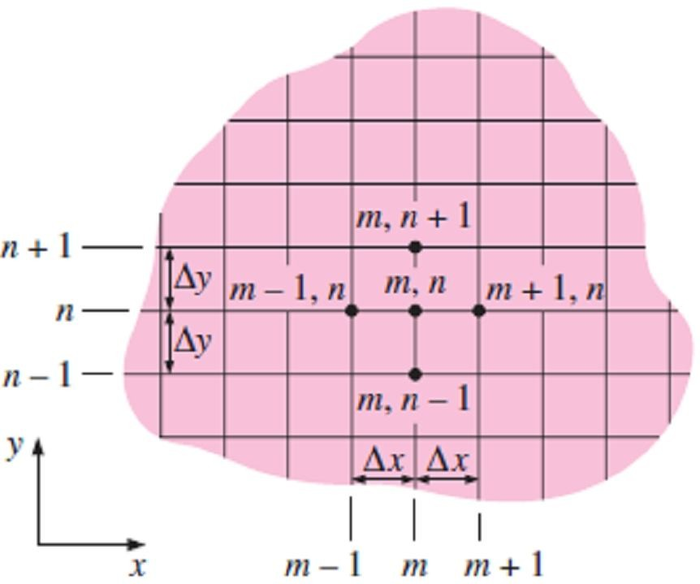
Chapter Five Numerical Heat Conduction
Noting that the second derivative is simply the derivative of the first derivative, the second derivative of temperature at node m can be expressed as;
dT ₋ dT
dx dx
T − T T − T
1
m +1 m ₋ m m −1
m −
2 ₌ Δx
2
1
d T
≅
m +
2
Δx
dx ²
m
Δx
Δx
₌ ^{T}m +1 ^{− 2T}m ^{+ T}m −1
☹(5.3)
Δx ²
which is the finite difference representation of the second derivative at a general internal node m. Note1- The second derivative of temperature at a node m is expressed in terms of the temperatures at node m and its two neighboring nodes.
Note2- According to above finite difference formulation, the following differential equation;
d ²T
+ ^{g} = 0 ☹ (5.4.a)
dx ² k
which is the governing equation for steady one-dimensional heat transfer in a plane wall with heat generation and constant thermal conductivity, can be expressed as follow;
^{T}m−1 ^{− 2T}m ^{+ T}m+1
+ ^{g m} = 0, m = 1, 2, 3, 😐, M − 1 ☹(5.4.b)
Δx ² k
Note3- The finite difference formulation above can easily be extended to two- or three-dimensional heat transfer problems by replacing each second derivative by a difference equation in that direction. For example, the finite difference formulation for steady two-dimensional heat conduction in a region with heat generation and constant thermal conductivity as shown in Fig.(5.3) can be expressed in rectangular coordinates as follow,
^{T}m+1, n ^{− 2T}m , n ^{+ T}m−1, n ₊ ^{T}m, n+1 ^{− 2T}m, n ^{+ T}m , n−1 ₊ ^{g} m, n ₌ ₀
Δx ² Δy ² k
☹(5.5)
for m = 1, 2, 3, . . . , M -1 and n = 1, 2, 3, . . . , N -1 at any interior node (m, n).
Note4- A rectangular region that is divided into M equal sub-regions in the x-direction and N equal sub-regions in the y-direction has a total of (M+1)(N+1) nodes, and Eq.(5.5) can be used to obtain the finite difference equations at (M-1)(N-1) of these nodes (i.e., all nodes except those at the boundaries).
Note5- The finite difference formulation is given above to demonstrate how difference equations are obtained from differential equations. However, we will use the energy balance approach in the following sections to obtain the numerical formulation because it is more intuitive and can
handle boundary conditions more easily. Besides, the energy balance approach does not require having the differential equation before the analysis.
Fig.(5.3) Finite difference mesh for two-dimensional conduction in rectangular coordinates

Slide 3
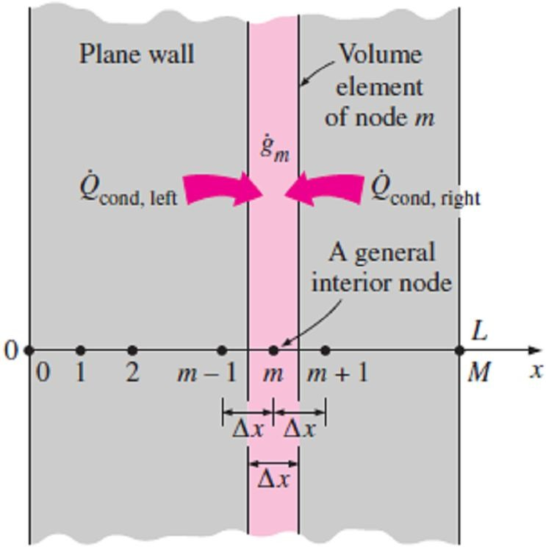
Chapter Five
Numerical Heat Conduction
5.3- One-Dimensional Steady Heat Conduction
In this section we’ll develop the finite difference formulation of heat conduction in a plane wall using the energy balance approach. The energy balance method is based on subdividing the medium into an enough number of volume elements and then applying an energy balance on each element. To explain that approach, again consider steady one-dimensional heat transfer in a plane wall of thickness L with heat generation g(x) and constant conductivity k.
Note1- The wall is now subdivided into M equal regions of thickness Δx = L/M in the x-direction, and the divisions between the regions are selected as the nodes. Therefore, we have M + 1 nodes labeled 0, 1, 2, . . . , m -1, m, m + 1, . . . , M, as shown in Fig.(5.4). The x-coordinate of any node m is simply x_{m} = m Δx, and the temperature at that point is T(x_{m}) = T_{m}.
Note2- Elements are formed by drawing vertical lines through the
Fig.(5.4) The nodal points and volume elements for the finite difference formulation of one-dimensional conduction in a plane wall
midpoints between the nodes.
Note3- All interior elements represented by interior nodes are full-
size elements (they have a thickness of Δx), whereas the two
elements at the boundaries are half-sized (they have a thickness of
Δx /2).
5.3.1- Energy Balance Method for The Interior Nodes
To obtain a general difference equation for the interior nodes, consider the element represented by node m and the two neighboring nodes m-1 and m+1. Assuming the heat conduction to be into the element on all surfaces, an energy balance on the element can be expressed as;
⎛Rate of heat ⎞ ⎛Rate of heat ⎞ ⎛Rate of heat ⎞ ⎛Rate of change ⎞
⎜ ⎟ ⎜ ⎟ ⎜ ⎟ ⎜ ⎟
⎜ conduction ⎟ ₊ ⎜ conduction ⎟ ₊ ⎜ generation ⎟ ₌ ⎜ of the energy ⎟
⎜
⎜
⎝
at the left ⎟ ⎜ at the right ⎟ ⎜ inside the
⎟ ⎜
⎟ ⎜
⎠ ⎝
content of the element
⎟
⎟
⎠
surface
⎟ ⎜
⎠ ⎝
surface
⎟ ⎜
⎠ ⎝
element
or;
_{Q}
Q
G
₌ ^{ΔE}element ₌ ₀
☹(5.6)
cond , left cond , right element
Δt
Note1- Above equation equal to zero since the energy content of a medium (or any part of it) does not change under steady conditions, and thus, ΔE_{element} = 0.
Note2- The rate of heat generation within the element can be expressed as;
^{G}element ^{= g} m ^{V}element ^{= g} m ^{A Δx}
☹(5.7.a)
where g_{m} is the rate of heat generation per unit volume in W/m³ evaluated at node m and treated as a constant for the entire element, and A is heat transfer area.
Note3- By assuming the temperature varies linearly, (In fact, such approximations are the reason for
classifying the numerical methods as approximate solution methods), Also by considering the direction of heat transfer on both surfaces of the element is assumed to be toward the node m, the rate of heat conduction at the left and right surfaces can be expressed as;
_{Q}
_{= k A} ^{T}m −1 ^{− T}m _{= k A} ^{T}m+1 ^{− T}m
cond , left
and
_{Q}
cond , right
☹(5.7.b)
Δx Δx
Thus, substituting Eqs.[(5.7.a) & (5.7.b)] into Eq.(5.6) gives;
_{k A} ^{T}m−1 ^{− T}m _{+ k A} ^{T}m+1 ^{− T}m
Δx Δx
+ g A Δx = 0
☹(5.8.a)
m

Slide 4
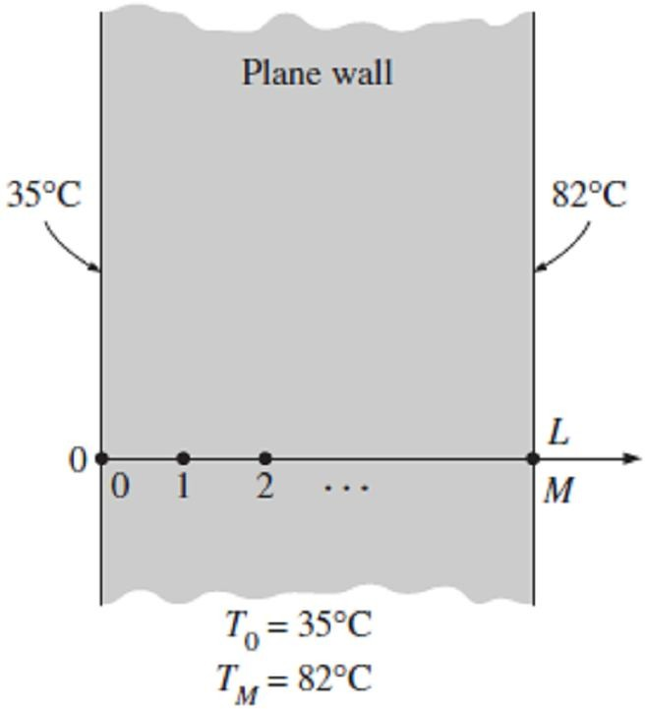
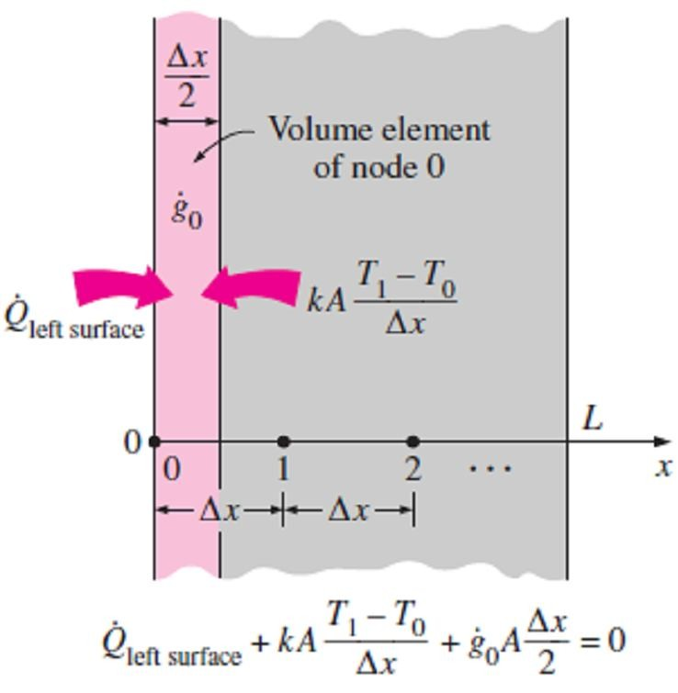
Chapter Five
Numerical Heat Conduction
or it can be simplified to;
^{T}m −1 ^{− 2T}m ^{+ T}m +1 ₊ ^{g} m _{= 0,}
m = 1, 2, 3, 😐, M − 1 ☹(5.8.b)
Δx² k
which is identical to the difference equation [Eq.(5.4.b)] obtained earlier.
5.3.2- Energy Balance Method for The Boundary Nodes
Boundary conditions most commonly encountered in practice are the specified temperature, specified heat flux, convection, and radiation boundary conditions, and here we develop the finite difference formulations for them for the case of steady one-dimensional heat conduction in a plane wall of thickness L as an example.
Note1- The node number at the left surface at x=0 is 0, while at the right surface at x=L it is M.
Note2- The width of the volume element for either boundary node is Δx/2.
Note3- The boundary conditions are divided into two types according to the needing or non-needing for doing the energy balance for the boundary element, as follow;
a- The boundary elements which do not need energy balance
I- Specified Temperature Boundary Condition: The specified temperature boundary condition is the simplest boundary condition to deal with. For one-dimensional heat transfer through a plane wall of thickness L, the specified temperature boundary conditions on both the left and right surfaces can be expressed as shown in Fig.(5.5), to be follow;
T (0) =T₀ = Specified value ⎫
☹(5.9)
T (L) = T = Specified value⎬
M
⎭
Fig.(5.5) Finite difference formulation of specified temperature boundary conditions on both surfaces
of a plane wall
where T₀ and T_{M} are the specified temperatures at surfaces at x=0
and x=L, respectively.
b- The boundary elements which need energy balance
When other boundary conditions such as the specified heat flux, convection, radiation, or combined convection and radiation conditions are specified at a boundary, the finite difference equation for the node at that boundary is obtained by writing an energy balance on the volume element at that boundary. The energy balance is again expressed as;
∑^{Q + G} element ⁼ ⁰
☹(5.10.a)
all sides
And thus, the finite difference formulation for the node at m=0 (or at the left boundary where x=0) of a plane wall of thickness L during steady one-dimensional heat conduction can be expressed as shown in Fig.(5.6), to be as follow;

T₁ − T₀
Δx
Fig.(5.6) Schematic for the finite difference formulation of the left boundary node of a plane wall
Q
left surface
k A
+ g ( A Δx / 2) = 0 ☹(5.10.b)
0
where as it is clear the boundary element has half thickness = Δx/2.
The finite difference form of various boundary conditions can be obtained from Eq.(5.10.b) by
replacing (Q_{left surface}) by a suitable expression. Next this is done for various boundary conditions at the left boundary, as follow;

Slide 5
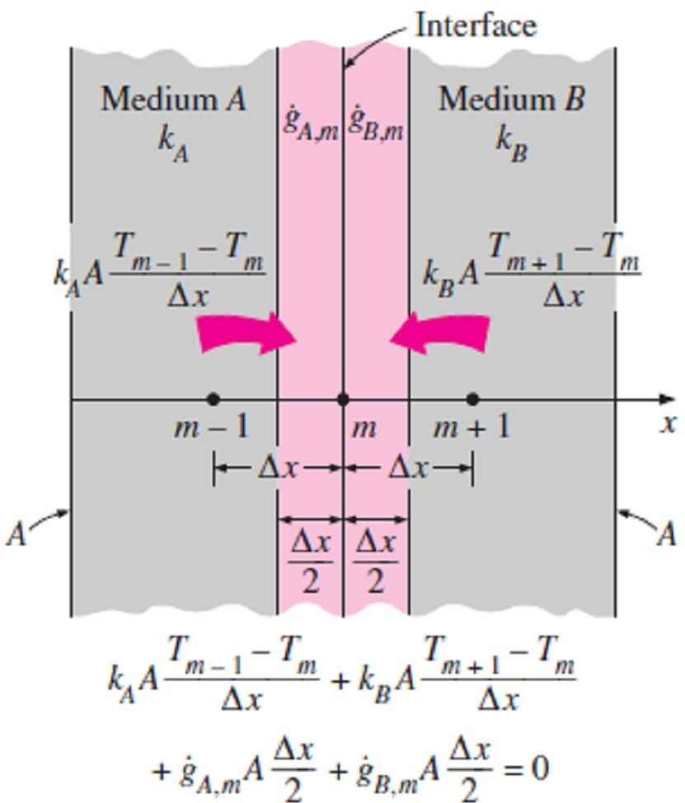
Chapter Five
Numerical Heat Conduction
I- Specified Heat Flux Boundary Condition:
q A + k A ^{T1 − T0} + g ( A Δx / 2) = 0
☹(5.11.a)
0 0
Δx
Special case: Insulated Boundary (q₀ = 0)
_{k A} T₁ − T₀
+ g ( A Δx / 2) = 0
☹(5.11.b)
Δx
0
II- Convection Boundary Condition:
h A(T − T ) + k A ^{T1 − T0} + g ( A Δx / 2) = 0
☹(5.11.c)
∞ 0 0
Δx
III- Radiation Boundary Condition:
⬧  A(T ⁴ − T ⁴ ) + k A ^{T1 − T0} + g ( A Δx / 2) = 0 ☹(5.11.d )
surr 0 0
Δx
IV- Combined Convection and Radiation Boundary Condition: as shown in Fig.(5.7)
h A(T − T ) +   A(T ⁴ − T ⁴ ) + k A ^{T1 − T0} + g ( A Δx / 2) = 0 ☹(5.11.e)
∞ 0 surr 0
Δx
0
or if (T_{surr}=T∞), above equation can be written as below;
h A(T − T ) + k A ^{T1 − T0} + g ( A Δx / 2) = 0
☹(5.11. f )
combined ∞ 0 0
Δx
V- Combined Convection, Radiation, and Specified Heat Flux Boundary Condition:
q A + h A(T − T ) +   A(T ⁴ − T ⁴ ) + k A ^{T1 − T0} + g ( A Δx / 2) = 0 ☹(5.11.g)
0 ∞ 0 surr 0
Δx
0
VI- Interface Boundary Condition:
Two different solid media A and B are assumed to be in perfect contact, and thus at the same temperature at the interface at node m as shown in Fig.(5.7). Subscripts A and B indicate properties of media A and B, respectively. Thus we have;
k _{A} A
^{T}m −1 ^{− T}m ^{T}m + 1 ^{− T}m
k _{B} A
+ g _{A, m} ( A Δx / 2) + g _{A, m} ( A Δx / 2) = 0
☹(5.11.h)
Δx Δx
Fig.(5.7) Schematic for the finite difference formulation of the interface boundary condition for
two mediums A and B that are in perfect thermal contact

Slide 6
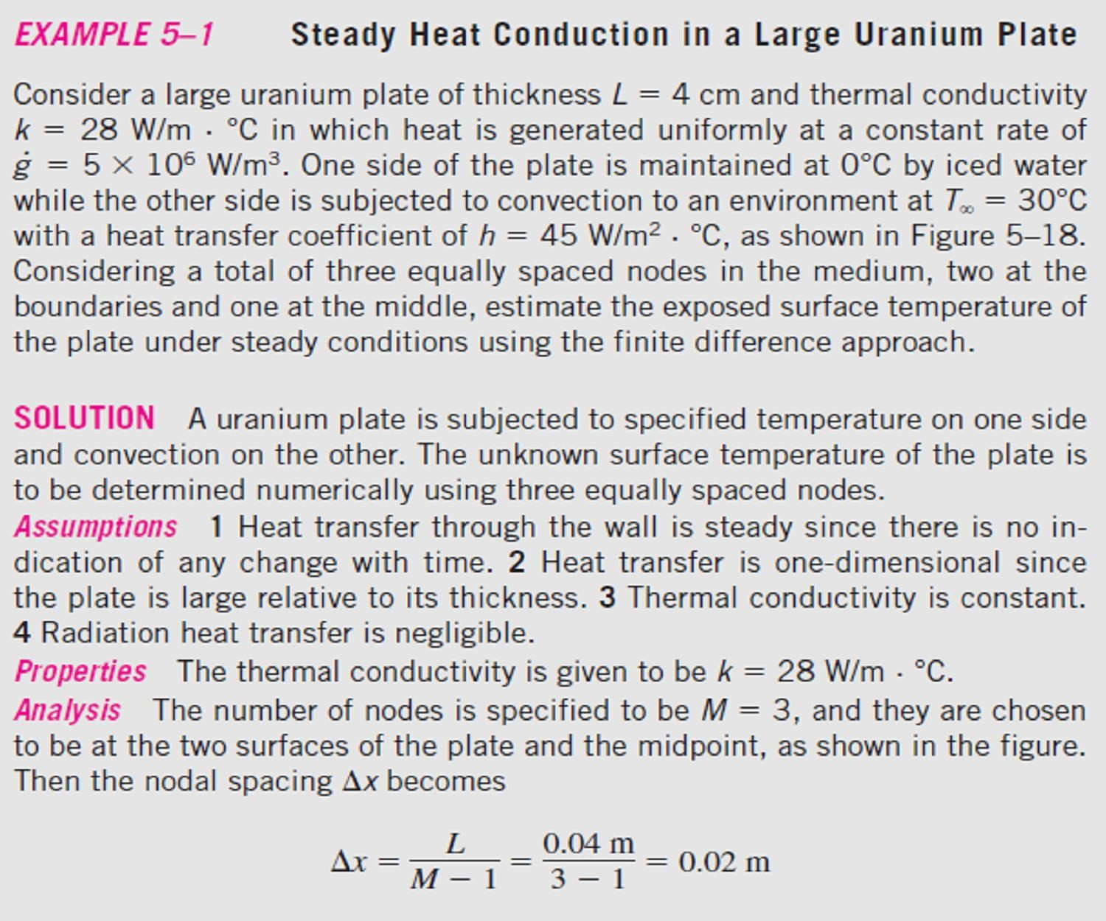
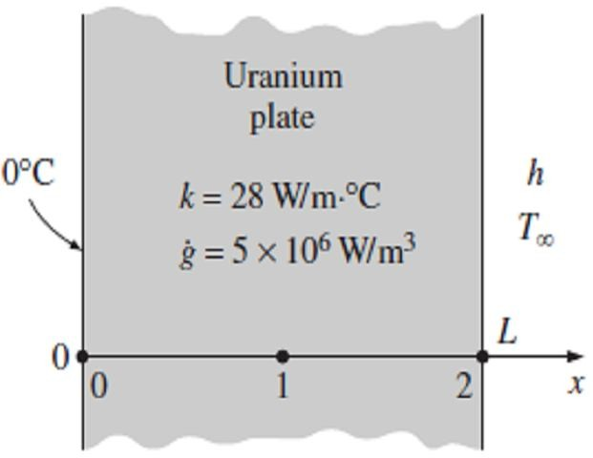
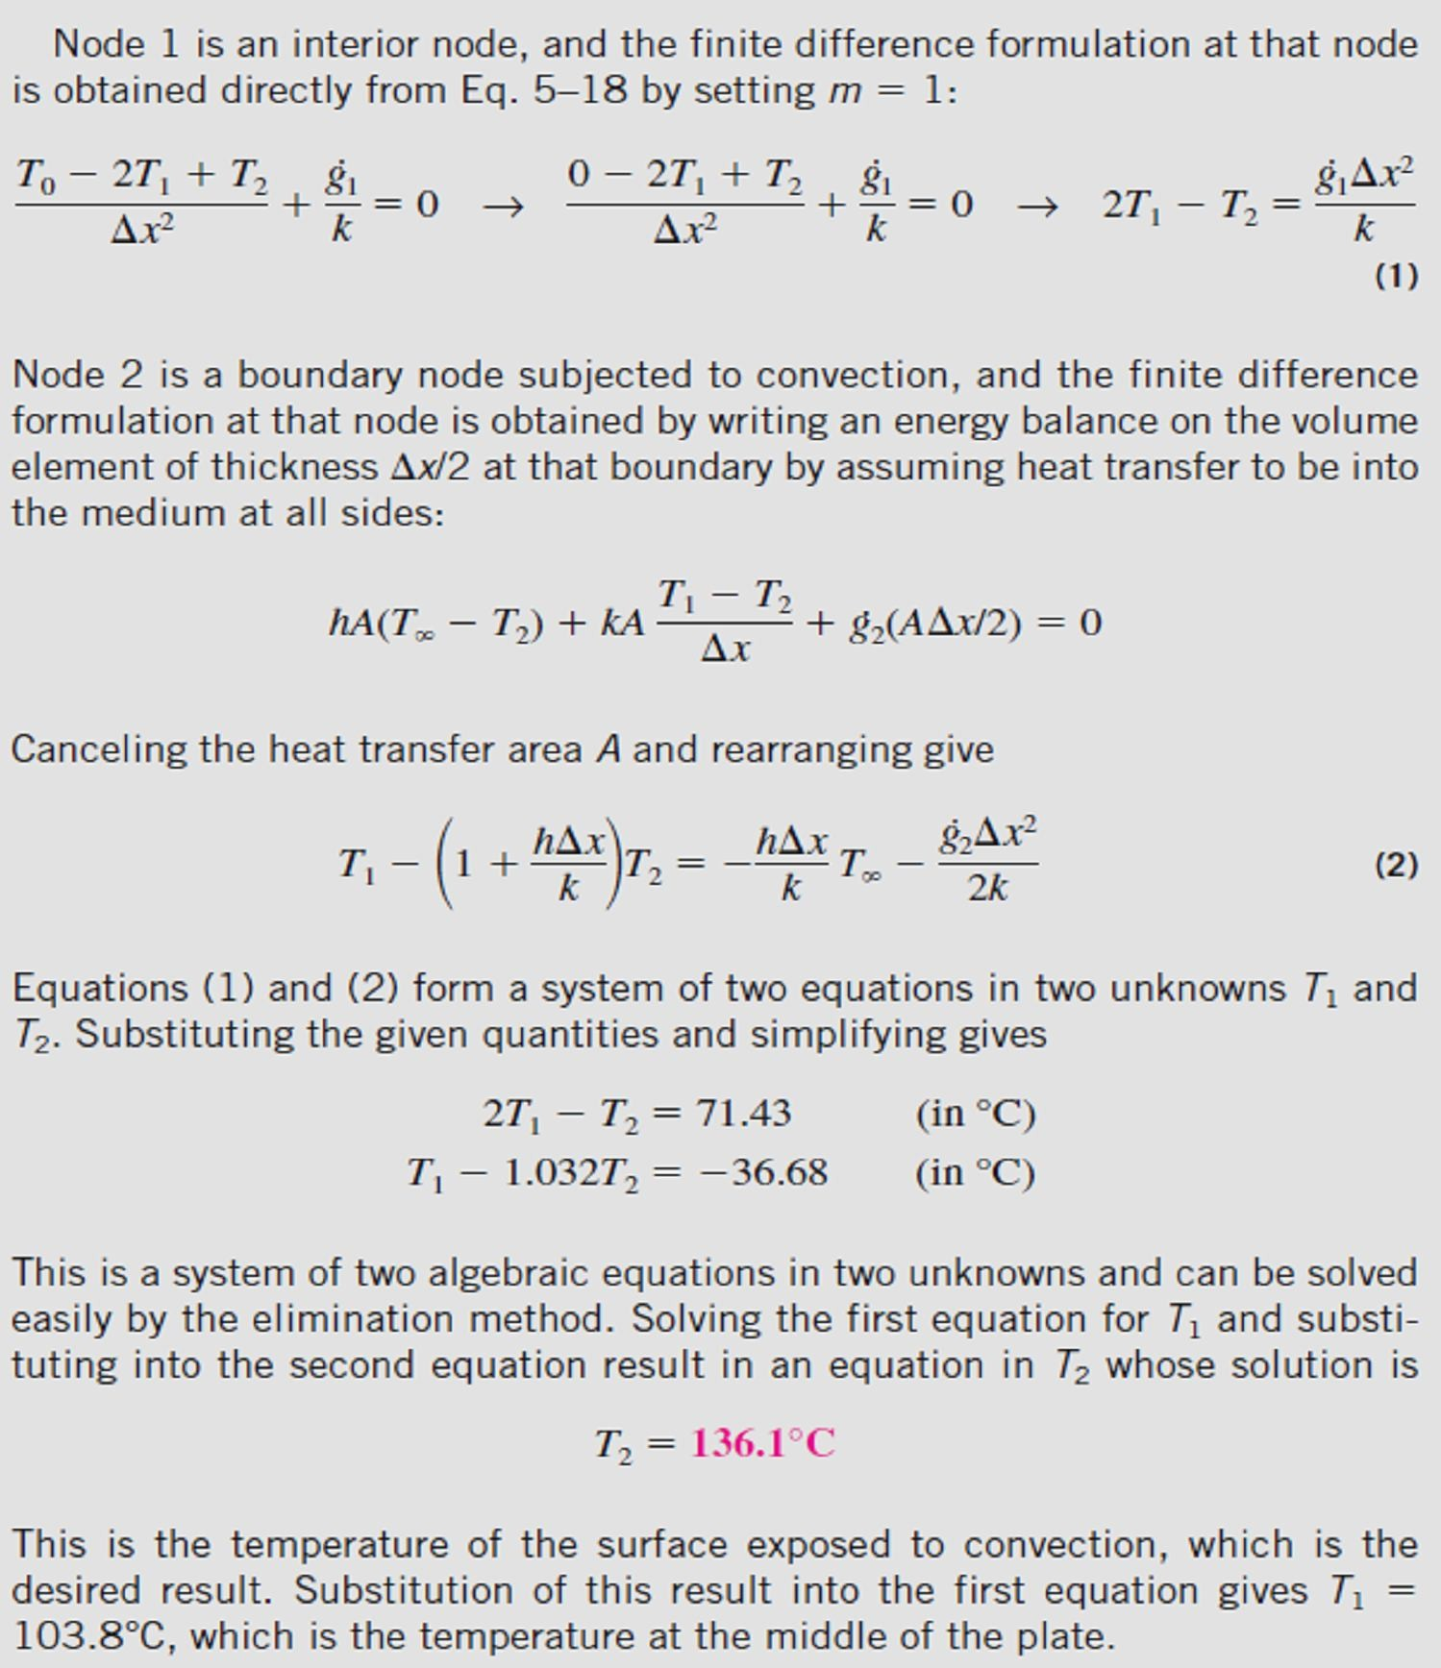
Chapter Five
Numerical Heat Conduction
(5.8).
Fig.(5.8) Schematic for Example- 5.1

Slide 7
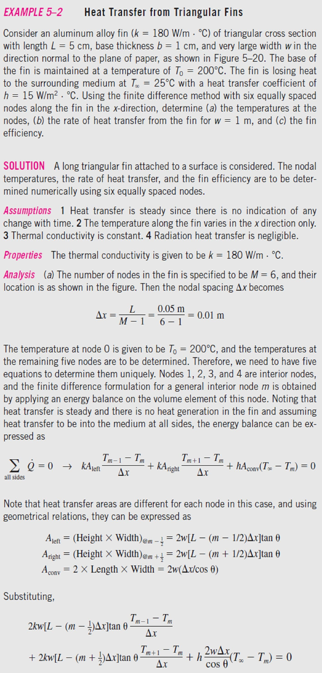
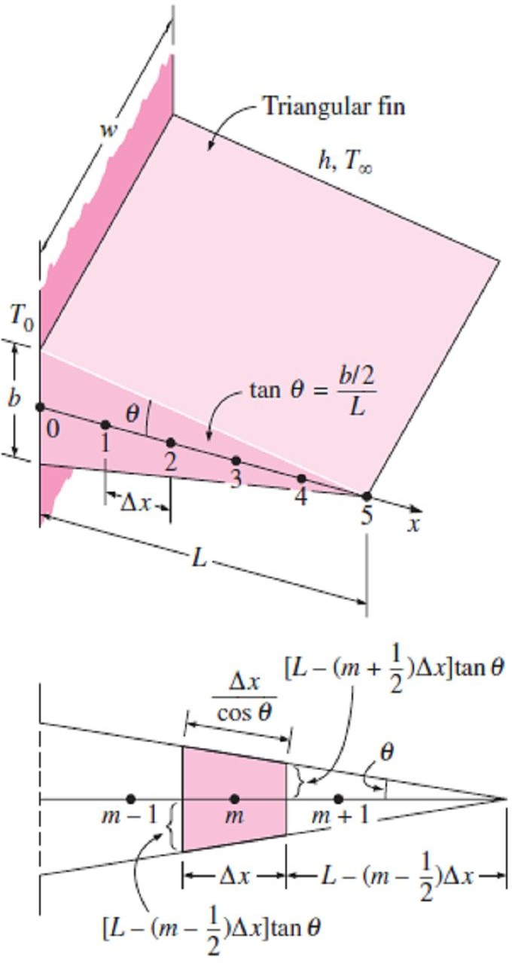
Chapter Five
Numerical Heat Conduction
(5.9).
Fig.(5.9) Schematic for Example- 5.2

Slide 8
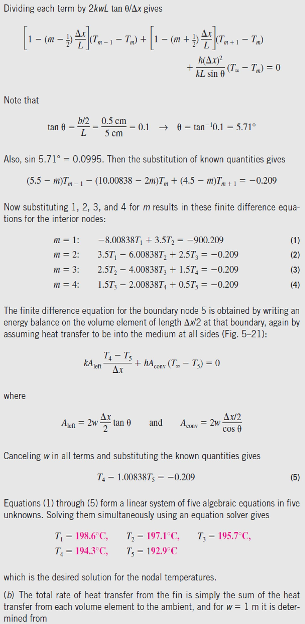
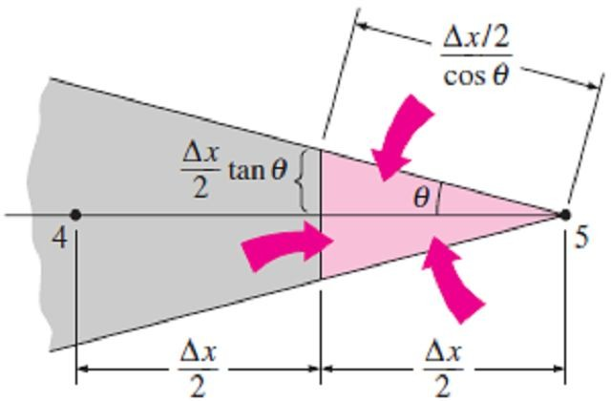
Chapter Five
Numerical Heat Conduction
Fig.(5.10) Schematic of the volume element of node 5 at the tip of a triangular fin
Fig.(5.10);

Slide 9
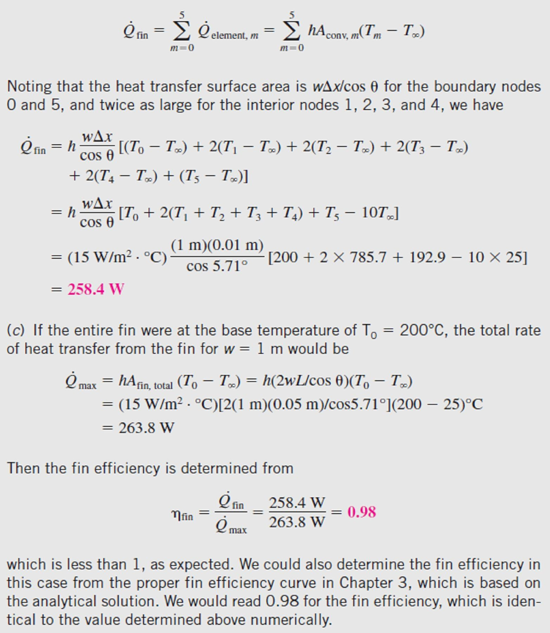
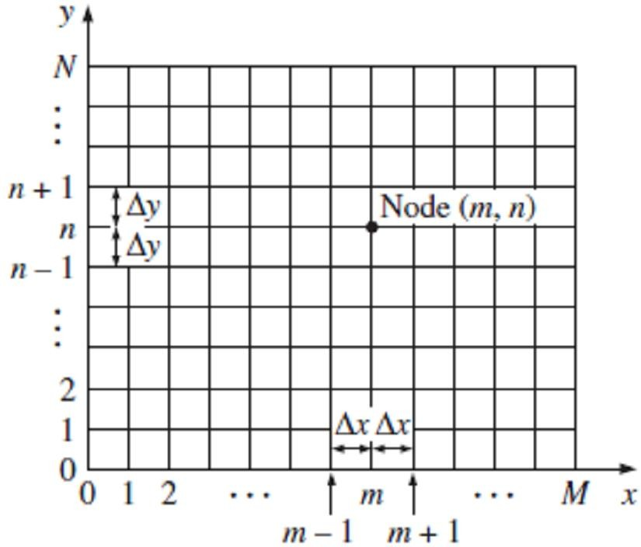
Chapter Five
Numerical Heat Conduction
5.4- Two-Dimensional Steady Heat Conduction
Consider a rectangular region in which heat conduction is significant in the x- and y-directions. Now divide the x-y plane of the region into a rectangular mesh of nodal points spaced Δx and Δy apart in the x- and y-directions, respectively, as shown in Fig.(5.11), and consider a unit depth of Δz =1 in the z-direction. A double subscript notation (m, n) will be used to define the temperature at each node, where m = 0, 1, 2, . . . , M is the node count in the x-direction and n = 0, 1, 2, . . . , N is the node count in the y-direction. The coordinates of the node (m, n) are simply x = m Δx and y = n Δy, and the temperature at the node (m, n) is denoted by T_{m, n}.
5.4.1- Energy Balance Method for The Interior Nodes Now consider a volume element of size Δx × Δy × 1 centered about a general interior node (m, n) in a region in which heat is
generated at a rate of and the thermal conductivity k is constant, as shown in Fig.(5.12). the energy balance on the volume element can be expressed as;
g
Fig.(5.11) The nodal network for the finite difference formulation of two-dimensional conduction
in rectangular coordinates

Slide 10
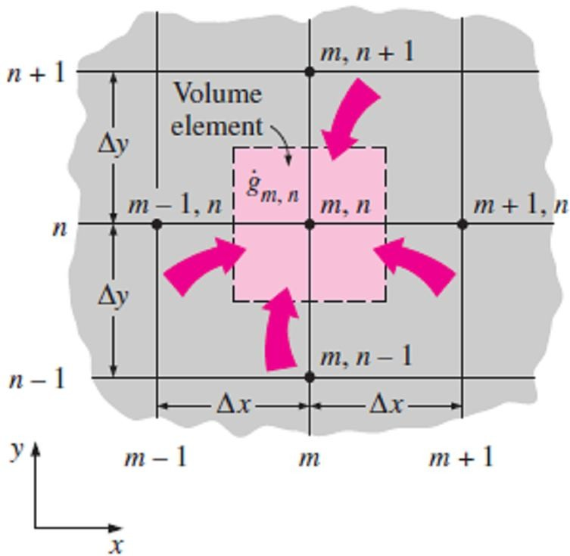
Chapter Five
Numerical Heat Conduction
⎛Rateof heat conduction⎞ ⎛ Rateof heat
⎞ ⎛Rateof changeof ⎞
⎜ ⎟ ⎜
⎜
⎟ ⎜ ⎟
⎜
at the left, top, right, ⎟ + ⎜generationinside⎟ = ⎜ the energycontent⎟
and bottomsurfaces
⎟ ⎜
⎟ ⎜
⎟
⎝
or;
theelement of the element
⎠ ⎝ ⎠ ⎝
⎠
^{Q}cond , left ^{+ Q} cond , top ^{+ Q} cond , right ^{+ Q} cond , bottom
G
element
₌ ^{ΔE}element ₌ ₀
☹(5.12)
Δt
Note1- Again assuming the following assumptions for the steady state case;
1- The direction of heat conduction will be toward the node
under consideration at all surfaces.
2- The temperatures between the adjacent nodes varies linearly.
Fig.(5.12) The volume element of a general interior node (m, n) for two-dimensional conduction in rectangular coordinates
Thus, with noting that the heat transfer area is A_{x} = Δy × 1 = Δy
in the x-direction and A_{y} = Δx × 1 = Δx in the y-direction, the
energy balance relation above becomes;
k Δy
^{T}m−1, n ^{− T}m, n ^{T}m, n+1 ^{− T}m, n
^{T}m+1, n ^{− T}m, n
^{T}m, n−1 ^{− T}m, n
k Δx
k Δy
k Δx
+ g _{m, n} Δx Δy = 0
☹(5.13.a)
Δx Δy
Δx
Δy
Dividing each term by Δx × Δy and simplifying gives;
^{T}m−1, n ^{− 2T}m, n ^{+ T}m+1, n ₊ ^{T}m, n−1 ^{− 2T}m , n ^{+ T}m, n+1 ₊ ^{g} m , n ₌ ₀
Δx ² Δy ² k
☹(5.13.b)
for m =1, 2, 3, . . . , M-1 and n =1, 2, 3, . . . , N-1. This equation is identical to Eq.(5.5) obtained earlier by replacing the derivatives in the differential equation by differences for an interior node (m, n).
Note2- In finite difference analysis, usually a square mesh is used for simplicity (except when the magnitudes of temperature gradients in the x- and y-directions are very different), and thus Δx and Δy
are taken to be the same. Then Δx = Δy = l, and the relation above simplifies to;
g
m , n
_{l} 2
= 0 ☹ (5.14)
^{T}m −1, n ^{+ T}m , n +1 ^{+ T}m +1, n ^{+ T}m , n −1 ^{− 4T}m , n ⁺
k
Note3- The finite difference formulation of an interior node is obtained by adding the temperatures of the four nearest neighbors of the node, subtracting four times the temperature of the node itself, and adding the heat generation term. It can also be expressed in this form (which is easy to remember) as;
+
g
node
_{l} 2
= 0 ☹ (5.15)
^{T}left ^{+ T}top ^{+ T}right ^{+ T}bottom ^{− 4T}node
k
Note4- When there is no heat generation in the medium, the finite difference equation for an interior node further simplifies to be;
T
node
₌ ^{T}left ^{+ T}top ^{+ T}right ^{+ T}bottom
☹ (5.16)
4
which has the interesting interpretation that the temperature of each interior node is the arithmetic average of the temperatures of the four neighboring nodes.
5.4.2- Energy Balance Method for The Boundary Nodes
The development of finite difference formulation of boundary nodes in two-dimensional problems is similar to the development in the one-dimensional case discussed earlier. Again, the region is partitioned between the nodes by forming volume elements around the nodes, and an energy balance is written for each boundary node. Various boundary conditions can be handled as discussed for a plane wall, except that the volume elements in the two-dimensional case involve heat transfer in the

Slide 11
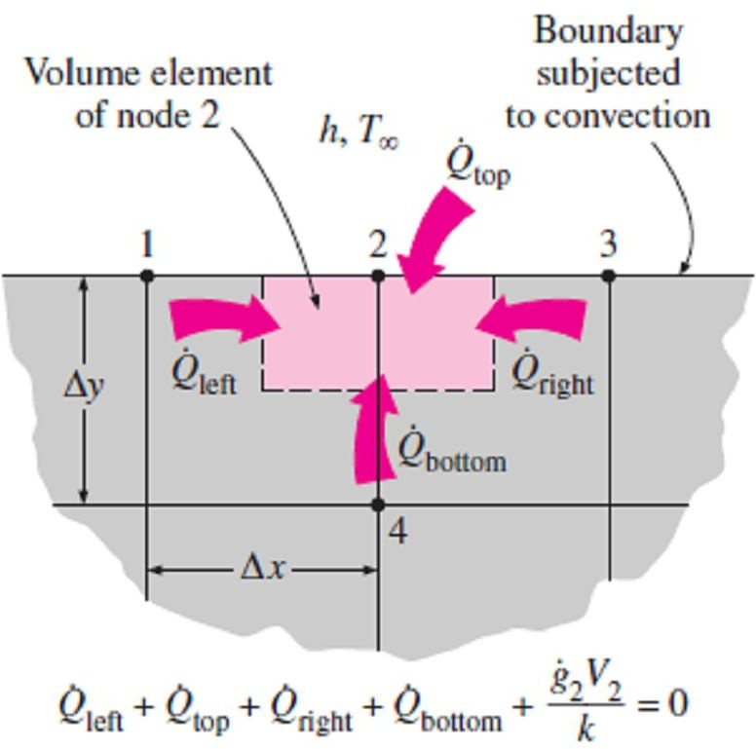
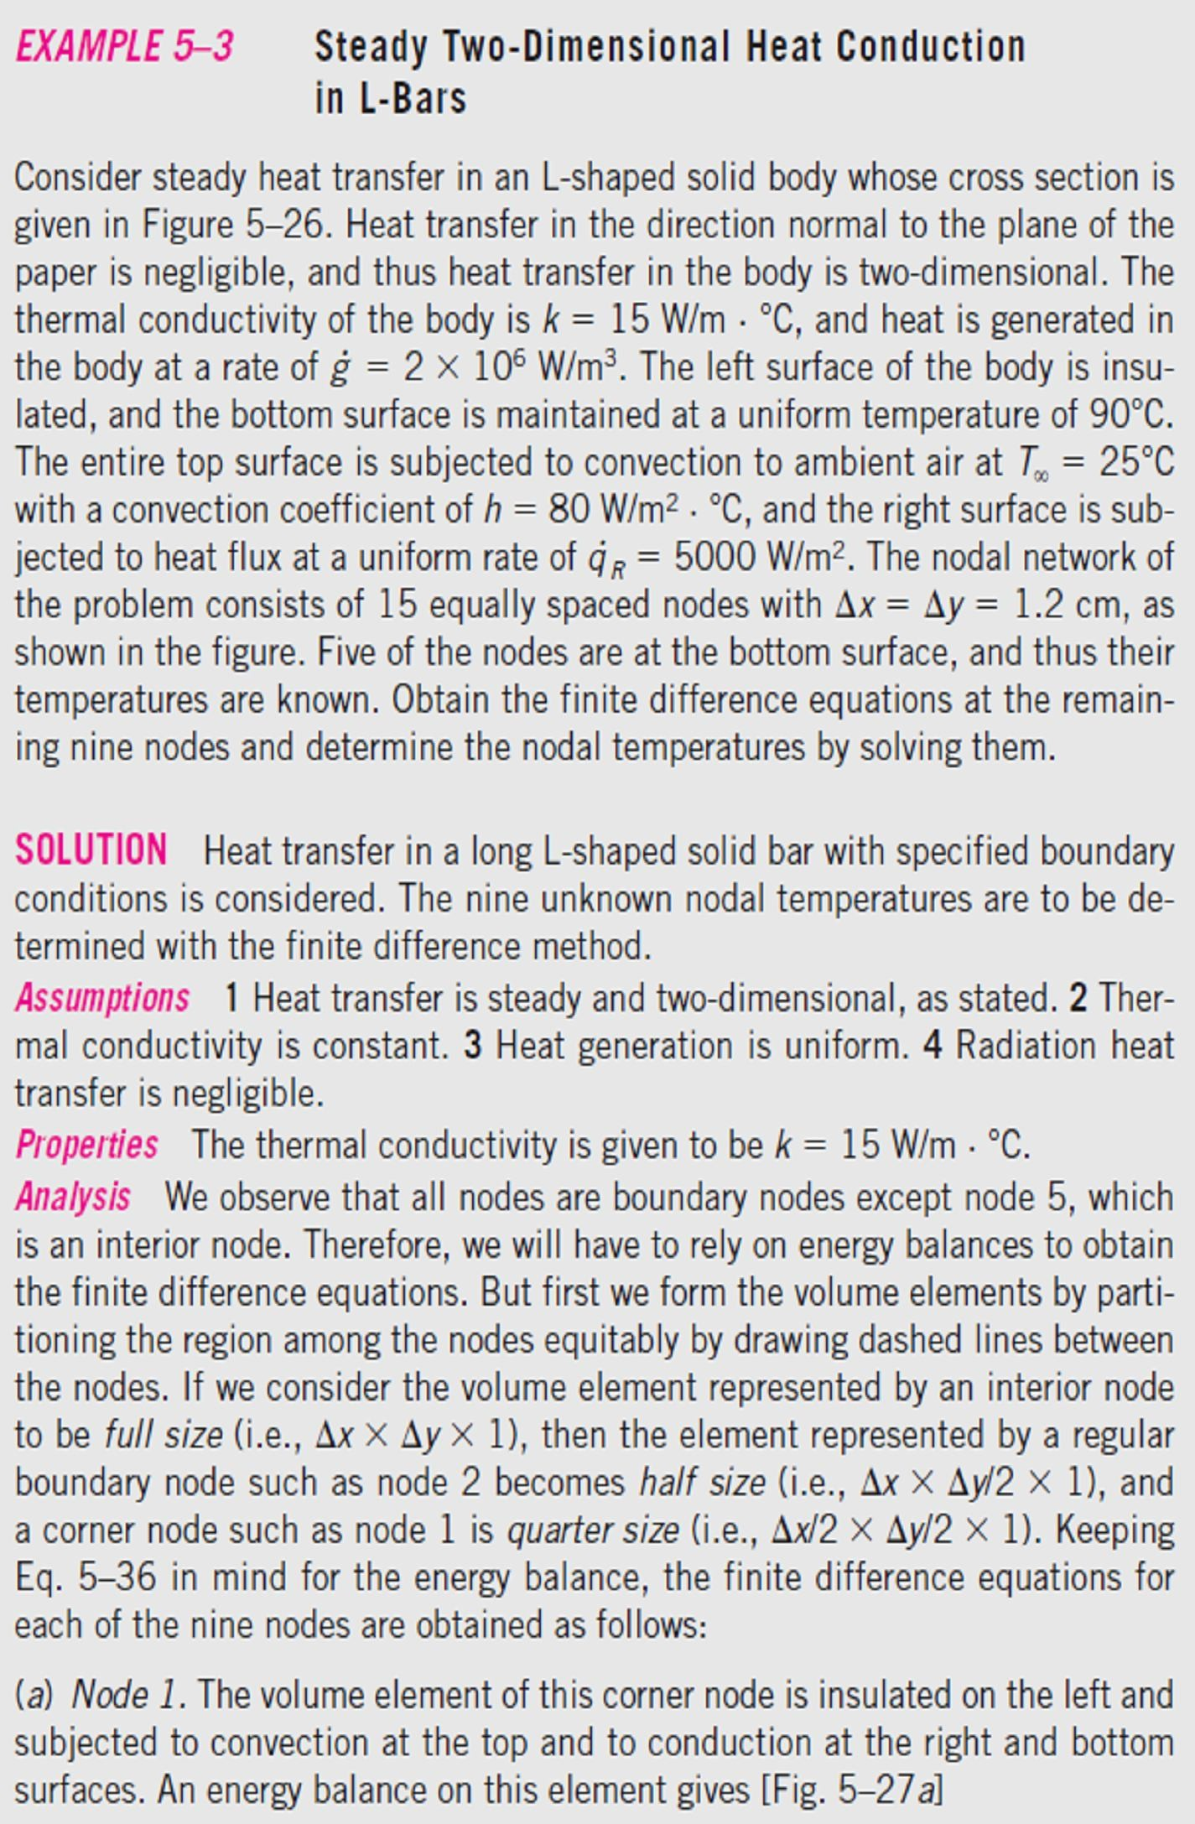
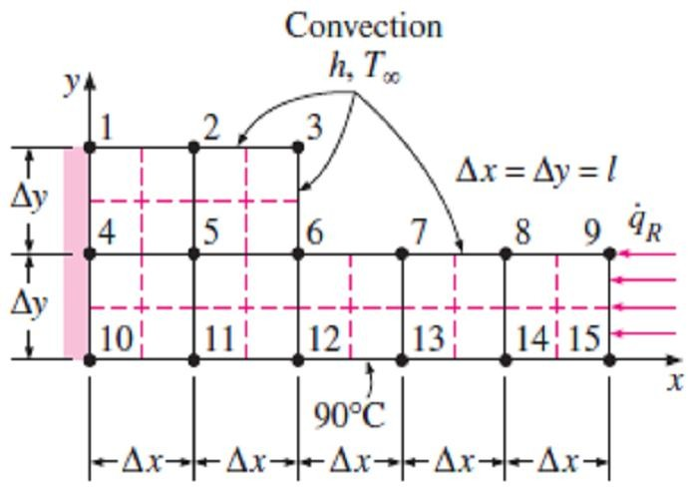
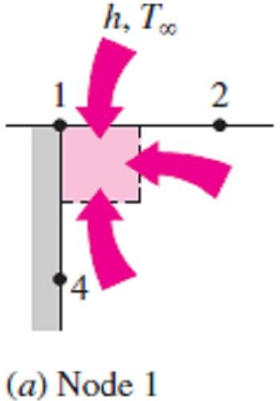
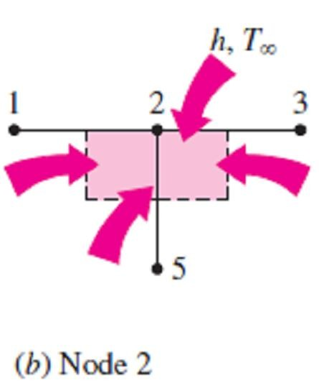
Chapter Five
Numerical Heat Conduction
y-direction as well as the x-direction.
For heat transfer under steady conditions, the finite difference equation for the node at that boundary is obtained by writing an energy balance on the volume element at that boundary, which can be expressed as shown in Fig.(5.13);
∑^{Q + g V}element ⁼ ⁰
☹(5.17)
Fig.(5.13) The finite difference formulation of a boundary node is obtained by writing an energy balance on its volume element
all sides
Note- Again, we'll assume all heat transfer to be into the volume element from all surfaces except for specified heat flux, whose direction is already specified.
Fig.(5.14) Schematic for Example-5.3 and the nodal network (the boundaries of volume elements of the nodes are indicated by dashed lines)

Slide 12
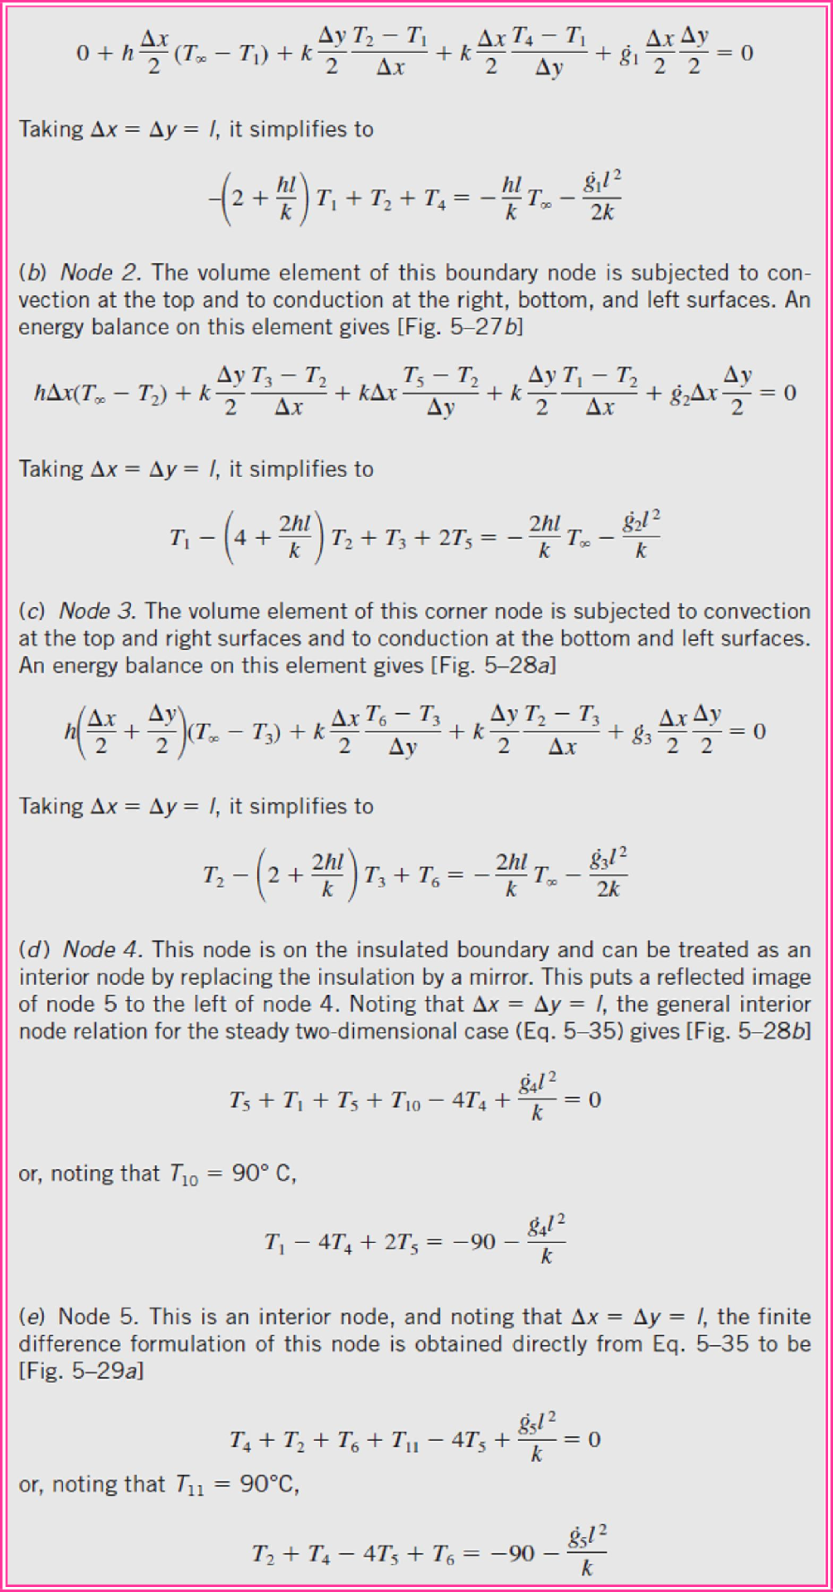
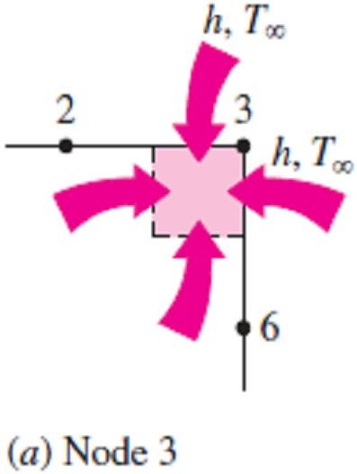
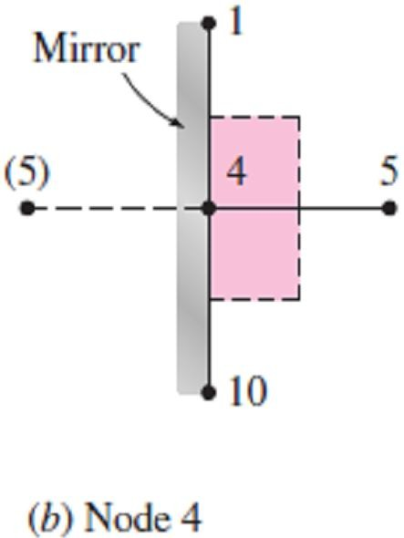
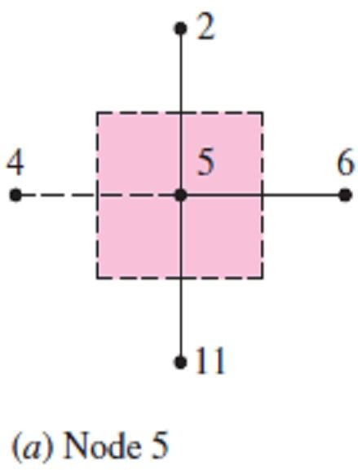
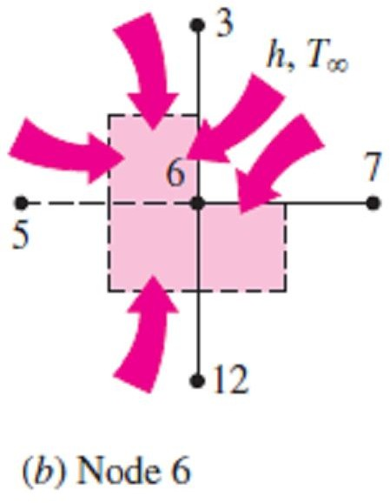
Chapter Five
Numerical Heat Conduction
Fig.(5.16) Schematics for energy balances on the volume elements of nodes 3 and 4

Slide 13
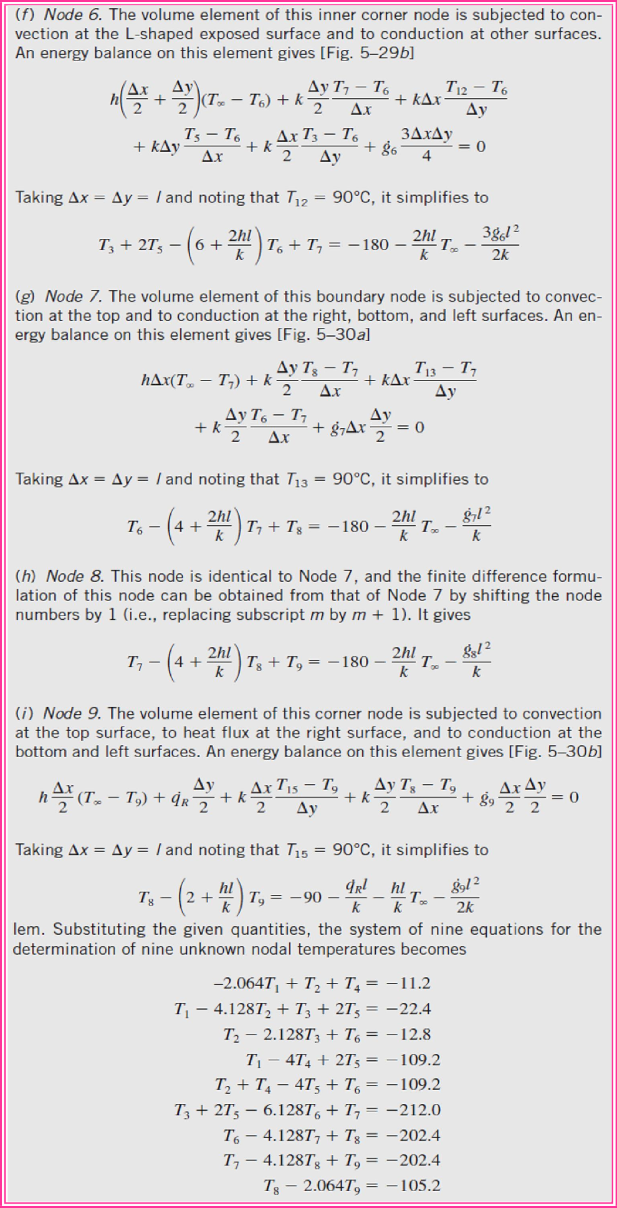
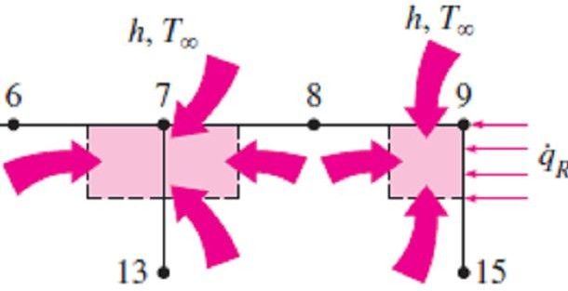
Chapter Five
Numerical Heat Conduction

Slide 14
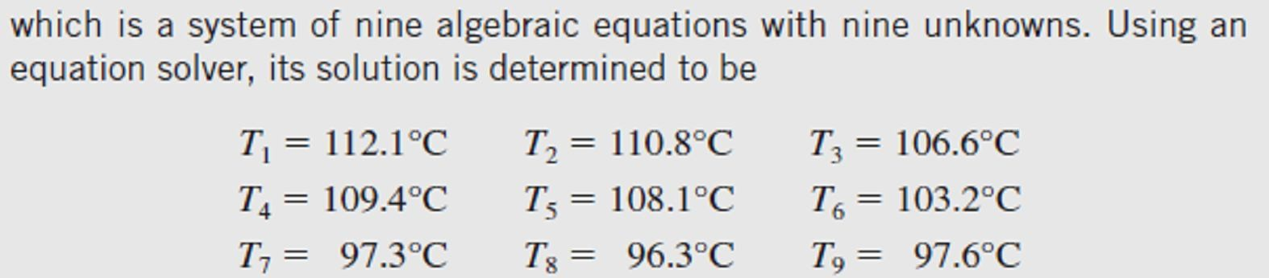
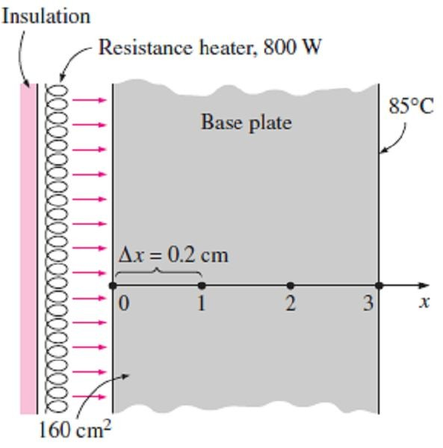
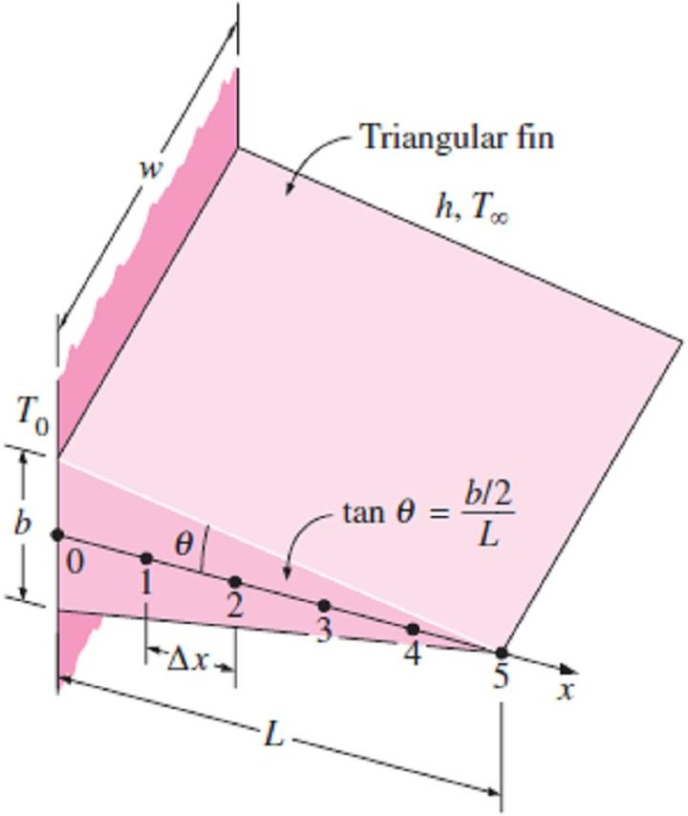
Chapter Five
Numerical Heat Conduction
PROBLEMS
5.1- Consider a large uranium plate of thickness 5cm and thermal conductivity k = 28 W/m ·C° in which heat is generated uniformly at a constant
rate of g = 6 × 10⁵ W/m³. One side of the plate is
insulated while the other side is subjected to convection to an environment at 30C° with a heat transfer coefficient of h = 60W/m²·C°. By Taking six equally spaced nodes with a nodal spacing of 1cm. Obtain the finite difference formulation of this problem and write the energy balance equation for each node.
5.3- Consider a large plane wall of thickness L= 0.4m, thermal conductivity k = 2.3 W/m ·C°, and surface area A = 20m². The left side of the wall is maintained at a constant temperature of 80C°, while the right side loses heat by convection to the surrounding air at T∞= 15C° with a heat transfer coefficient of h= 24 W/m² ·C°. Assuming steady one-dimensional heat transfer and taking the nodal spacing to be 10cm, obtain the finite difference formulation for all nodes.
5.4- Consider the base plate of a 800W house-
hold iron having a thickness of L = 0.6cm, base area of A = 160 cm², and thermal conductivity of k = 20 W/m ·C°. The inner surface of the base plate is subjected to uniform heat flux generated by the resistance heaters inside. When steady operating conditions are reached, the outer surface temperature of the plate is measured to be 85C°. Disregarding any heat loss through the upper part of the iron and taking the nodal spacing to be 0.2cm, obtain the finite difference formulation for the nodes.
5.2- Consider an aluminum alloy fin (k = 180 W/m · °C) of triangular cross section whose length is L = 5cm, base thickness is b = 1cm, and width w in the direction normal to the plane of paper is very large. The base of the fin is maintained at a temperature of T₀ = 180C°. The fin is losing heat by convection to the ambient air at T∞ = 25C° with a heat transfer coefficient of h= 25 W/m² ·C° and by radiation to surrounding surfaces at an average temperature of T_{surr}=290K. Using the finite difference method with six equally spaced nodes along the fin in the x- direction, determine the energy balance or differences equations at the considering nodes for w = 1m. Take the emissivity of the fin surface to be 0.9 and assume steady one-dimensional heat transfer in the fin.
Prob.(5.4)
5.5- A stainless steel spoon (k = 15.1 W/m ·C°, ε= 0.6) is partially immersed in boiling water at 95C° in a kitchen at 25C°. The handle of the spoon has a cross section of about 0.2cm × 1cm and extends 18cm in the air from the free surface of the water. The spoon loses heat by convection to the ambient air with an average heat transfer coefficient of h = 13W/m² ·C° and by radiation to the surrounding surfaces at an average temperature of T_{surr}= 295K. Assuming steady
Prob.(5.2)
one-dimensional heat transfer along the spoon and taking the nodal spacing to be 3cm, obtain the finite difference formulation for all nodes.

Slide 15
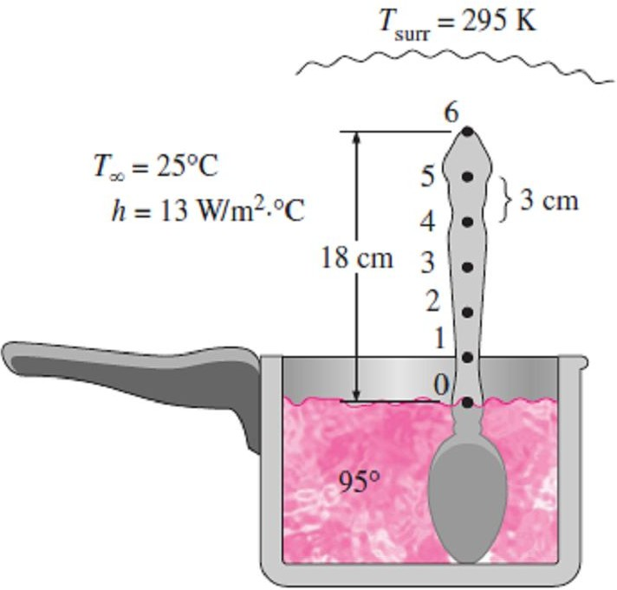
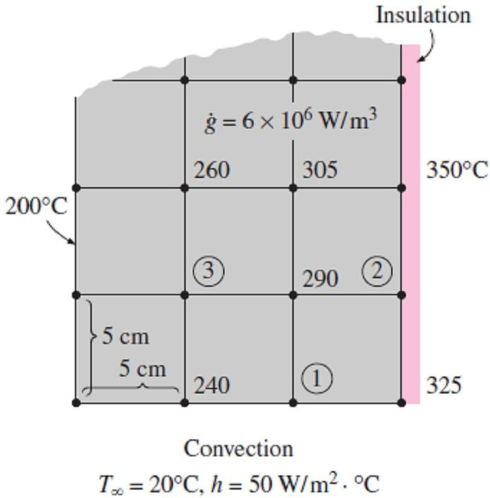
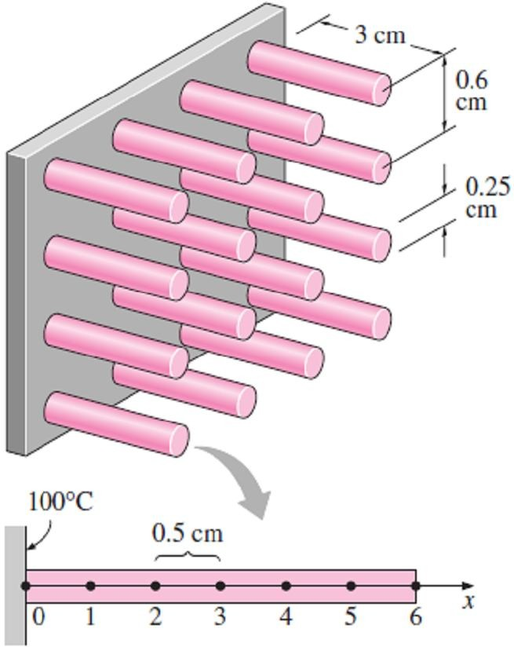
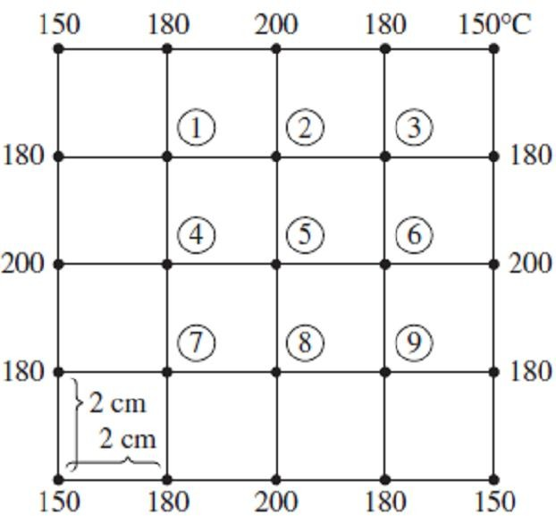
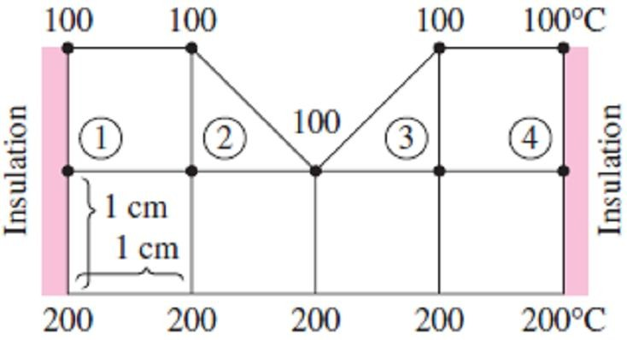
Chapter Five
Numerical Heat Conduction
Prob.(5.7)
Prob.(5.5)
5.6- A hot surface at 100C° is to be cooled by attaching 3cm-long, 0.25cm-diameter aluminum pin fins (k = 237 W/m ·C°) with a center-to- center distance of 0.6cm. The temperature of the surrounding medium is 30C°, and the combined heat transfer coefficient on the surfaces is 35 W/m²·C°. Assuming steady one-dimensional heat
5.8- Consider steady two-dimensional heat transfer in a long solid body whose cross section is given in the figure. The measured temperatures at selected points of the outer surfaces are as shown. The thermal conductivity of the body is k= 45 W/m ·C°, and there is no heat generation. Using the finite difference method with a mesh size of Δx = Δy = 2.0cm, determine the finite difference equations at the indicated points in the medium.
transfer along the fin and taking spacing to be 0.5cm, determine difference equation for each node.
the nodal the finite
Prob.(5.8)
5.9- Consider steady two-dimensional heat
transfer in a long solid bar whose cross section is given in the figure. The measured temperatures at selected points on the outer surfaces are as
Prob.(5.6)
shown. The thermal conductivity of the body is k= 20 W/m ·C°, and there is no heat generation. Using the finite difference method with a mesh size of Δx = Δy = 1.0cm, determine the finite difference equations at the indicated points in the medium.
Answers: 143C°, 136C°
5.7- Consider steady two-dimensional heat
transfer in a long solid body whose cross section is given in the next figure. The temperatures at the selected nodes and the thermal conditions at
the boundaries are as shown. The thermal conductivity of the body is k = 45 W/m ·C°, and heat is generated in the body uniformly at a rate of g = 6 × 10⁶ W/m³. Using the finite difference method with a mesh size of Δx = Δy = 5.0cm, determine (a) the temperatures at nodes 1, 2, and 3 and (b) the rate of heat loss from the bottom surface through a 1m-long section of the body.
Answers: 280.9C°, 397.1 C°, 330.8 C°, 1808 W
Prob.(5.9)

Slide 16
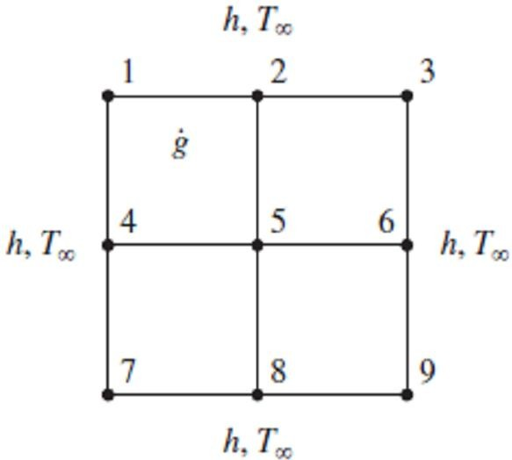
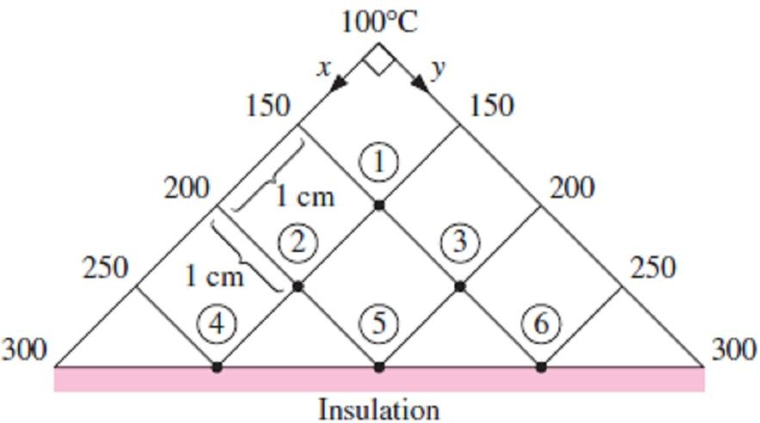
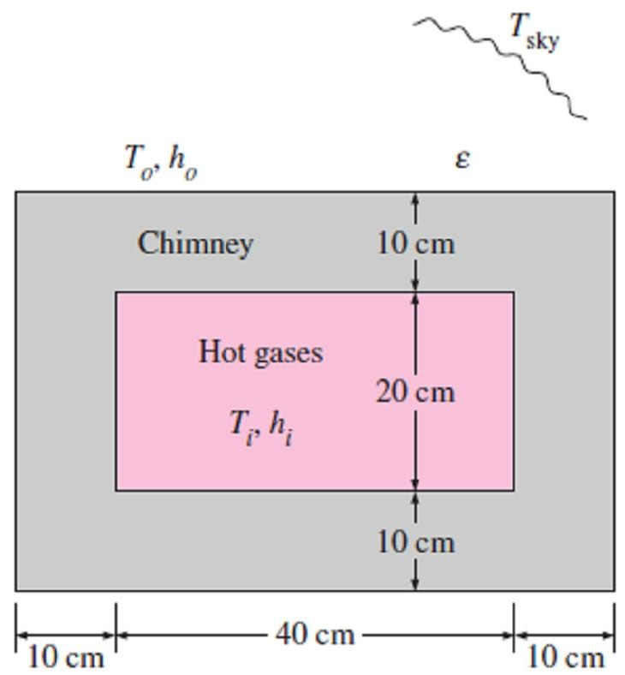
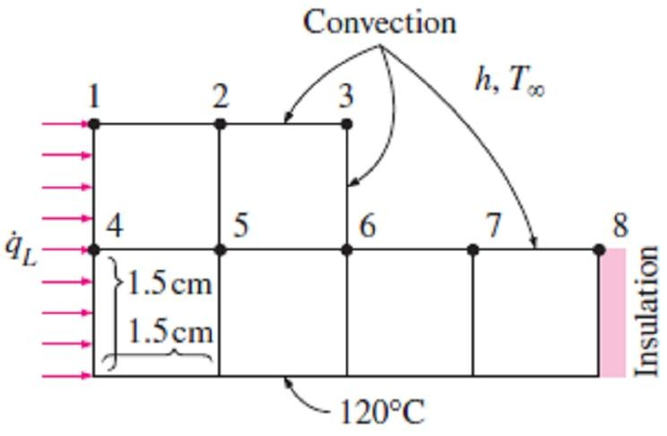
Chapter Five
Numerical Heat Conduction
5.10- Consider steady two-dimensional heat transfer in a long solid bar whose cross section is given in the figure. The measured temperatures at selected points on the outer surfaces are as shown. The thermal conductivity of the body is k= 20 W/m ·C°, and there is no heat generation. Using the finite difference method with a mesh size of Δx = Δy = 1.0cm, determine the finite difference equations at the indicated points in the medium.
of the bar are subjected to convection with the ambient air at T∞ = 70F° with a heat transfer coefficient of h = 7.9 Btu/h ·ft² ·F°. Using the finite difference method with a mesh size of Δx = Δy = 0.2ft, determine (a) the temperatures at the nine nodes and (b) the rate of heat loss from the bar through a 1ft-long section.
Answer: (b) 3040 Btu/h
Prob.(5.10)
Prob.(5.12)
5.13- Hot combustion gases of a furnace are flowing through a concrete chimney (k=1.4 W/m
C°) of rectangular cross section. The flow section of the chimney is 20cm×40cm, and the
thickness of the wall is 10cm. The average temperature of the hot gases in the chimney is
T_{i}=280C°, and the average convection heat transfer coefficient inside the chimney is h_{i} =75
W/m² ·C°. The chimney is losing heat from its outer surface to the ambient air at T_{o}=15C° by
convection with a heat transfer coefficient of h_{o}=
18 W/m² ·C° and to the sky by radiation. The emissivity of the outer surface of the wall is ε=0.9, and the effective sky temperature is estimated to be 250K. Using the finite difference method with Δx = Δy = 10cm, obtain the finite difference formulation of this problem for steady two-dimensional heat transfer.
5.11- Consider steady two-dimensional heat transfer in an L-shaped solid body whose cross section is given in the figure. The thermal conductivity of the body is k = 45 W/m ·C°, and heat is generated in the body at a rate of g =
5×10⁶ W/m³. The right surface of the body is insulated, and the bottom surface is maintained at a uniform temperature of 120C°. The entire top surface is subjected to convection with ambient air at T∞ = 30C° with a heat transfer coefficient of h=55 W/m²·C°, and the left surface is subjected to heat flux at a uniform rate of
q_{L} =8000 W/m². The nodal network of the problem consists of 13 equally spaced nodes with Δx = Δy = 1.5cm. Obtain the finite difference equation at each node of unknown temperature.
Prob.(5.11)
5.12- Consider steady two-dimensional heat transfer in a long solid bar of square cross section in which heat is generated uniformly at a rate of g = 0.19 × 10⁵ Btu/h ·ft³. The cross section of the bar is 0.4ft×0.4ft in size, and its thermal conductivity is k = 16 Btu/h ·ft ·F°. All four sides
Prob.(5.13)
5.14- Repeat Prob.(5.13) by neglecting radiation heat transfer from the outer surfaces of the chimney.

